Slide 1













DEPI-PROJECT-WEEK 1
1-Hagar Gamal
2-Farah Amr
3- Eman Mahomoud
Safaa Samy
Group leader
SQL part
python part
1- Safaa Samy
2- Basant Wael

Slide 2




















01
python notebook
Data describtion
05
creating python notebook for our data set
check quantiles
IQR
outliers
unique data
Our python notebook Workflow From Exploration to visualization
02
Importing libraries ,Dataset
Resolution
06
check columns name
renaming of some columns
adding column
count some data values
import pandas,matplotlip,
seaborn Dataset
03
Data Exploration
Testing and Verification
07
check Data shape ,Head ,tail and info
check cleaned dataset
04
Investigation
Data visualiziation
08
check Nulls dupplicates
missing values
creating some charts to visualize the data with a diffrent charts

Slide 3
week 2
Analysis Questions phase
1
2
1-Visualization
of data
2- Relationships
Classification of Questions according to different points of view .
(four points of view)

Slide 4
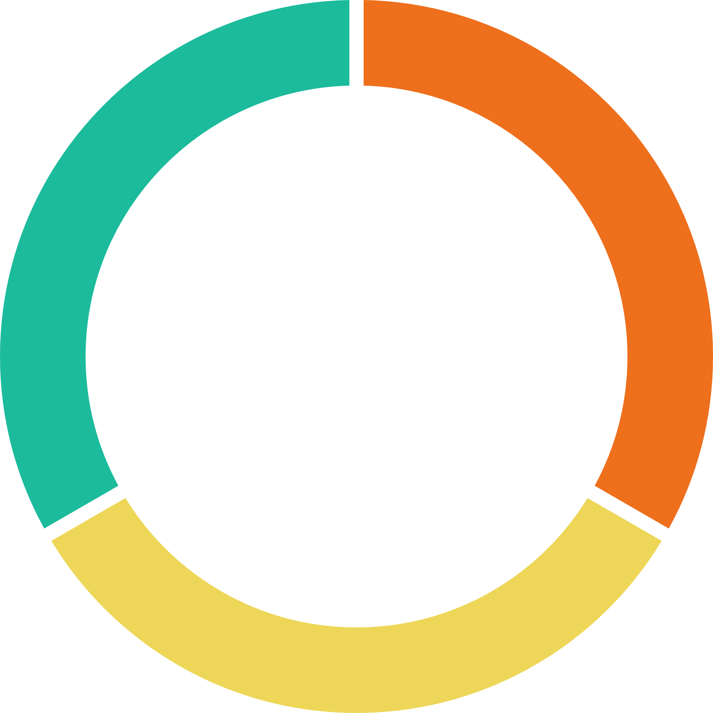
1. How does gender distribution correlate with product purchases?
2. Are customer age groups more likely to purchase a product from a specific product category than others?
1-Customers
3. Top 3 product popularity based on location.

Slide 5

1. What's the most used shipping method for each product category?
2-Shipping and Logistics
2. Are products with higher return rates associated with a specific shipping method?
4. What is the most cost-effective shipping method based on the average 'Shipping Cost'?
3. Which regions have the highest 'Shipping Costs?

Slide 6
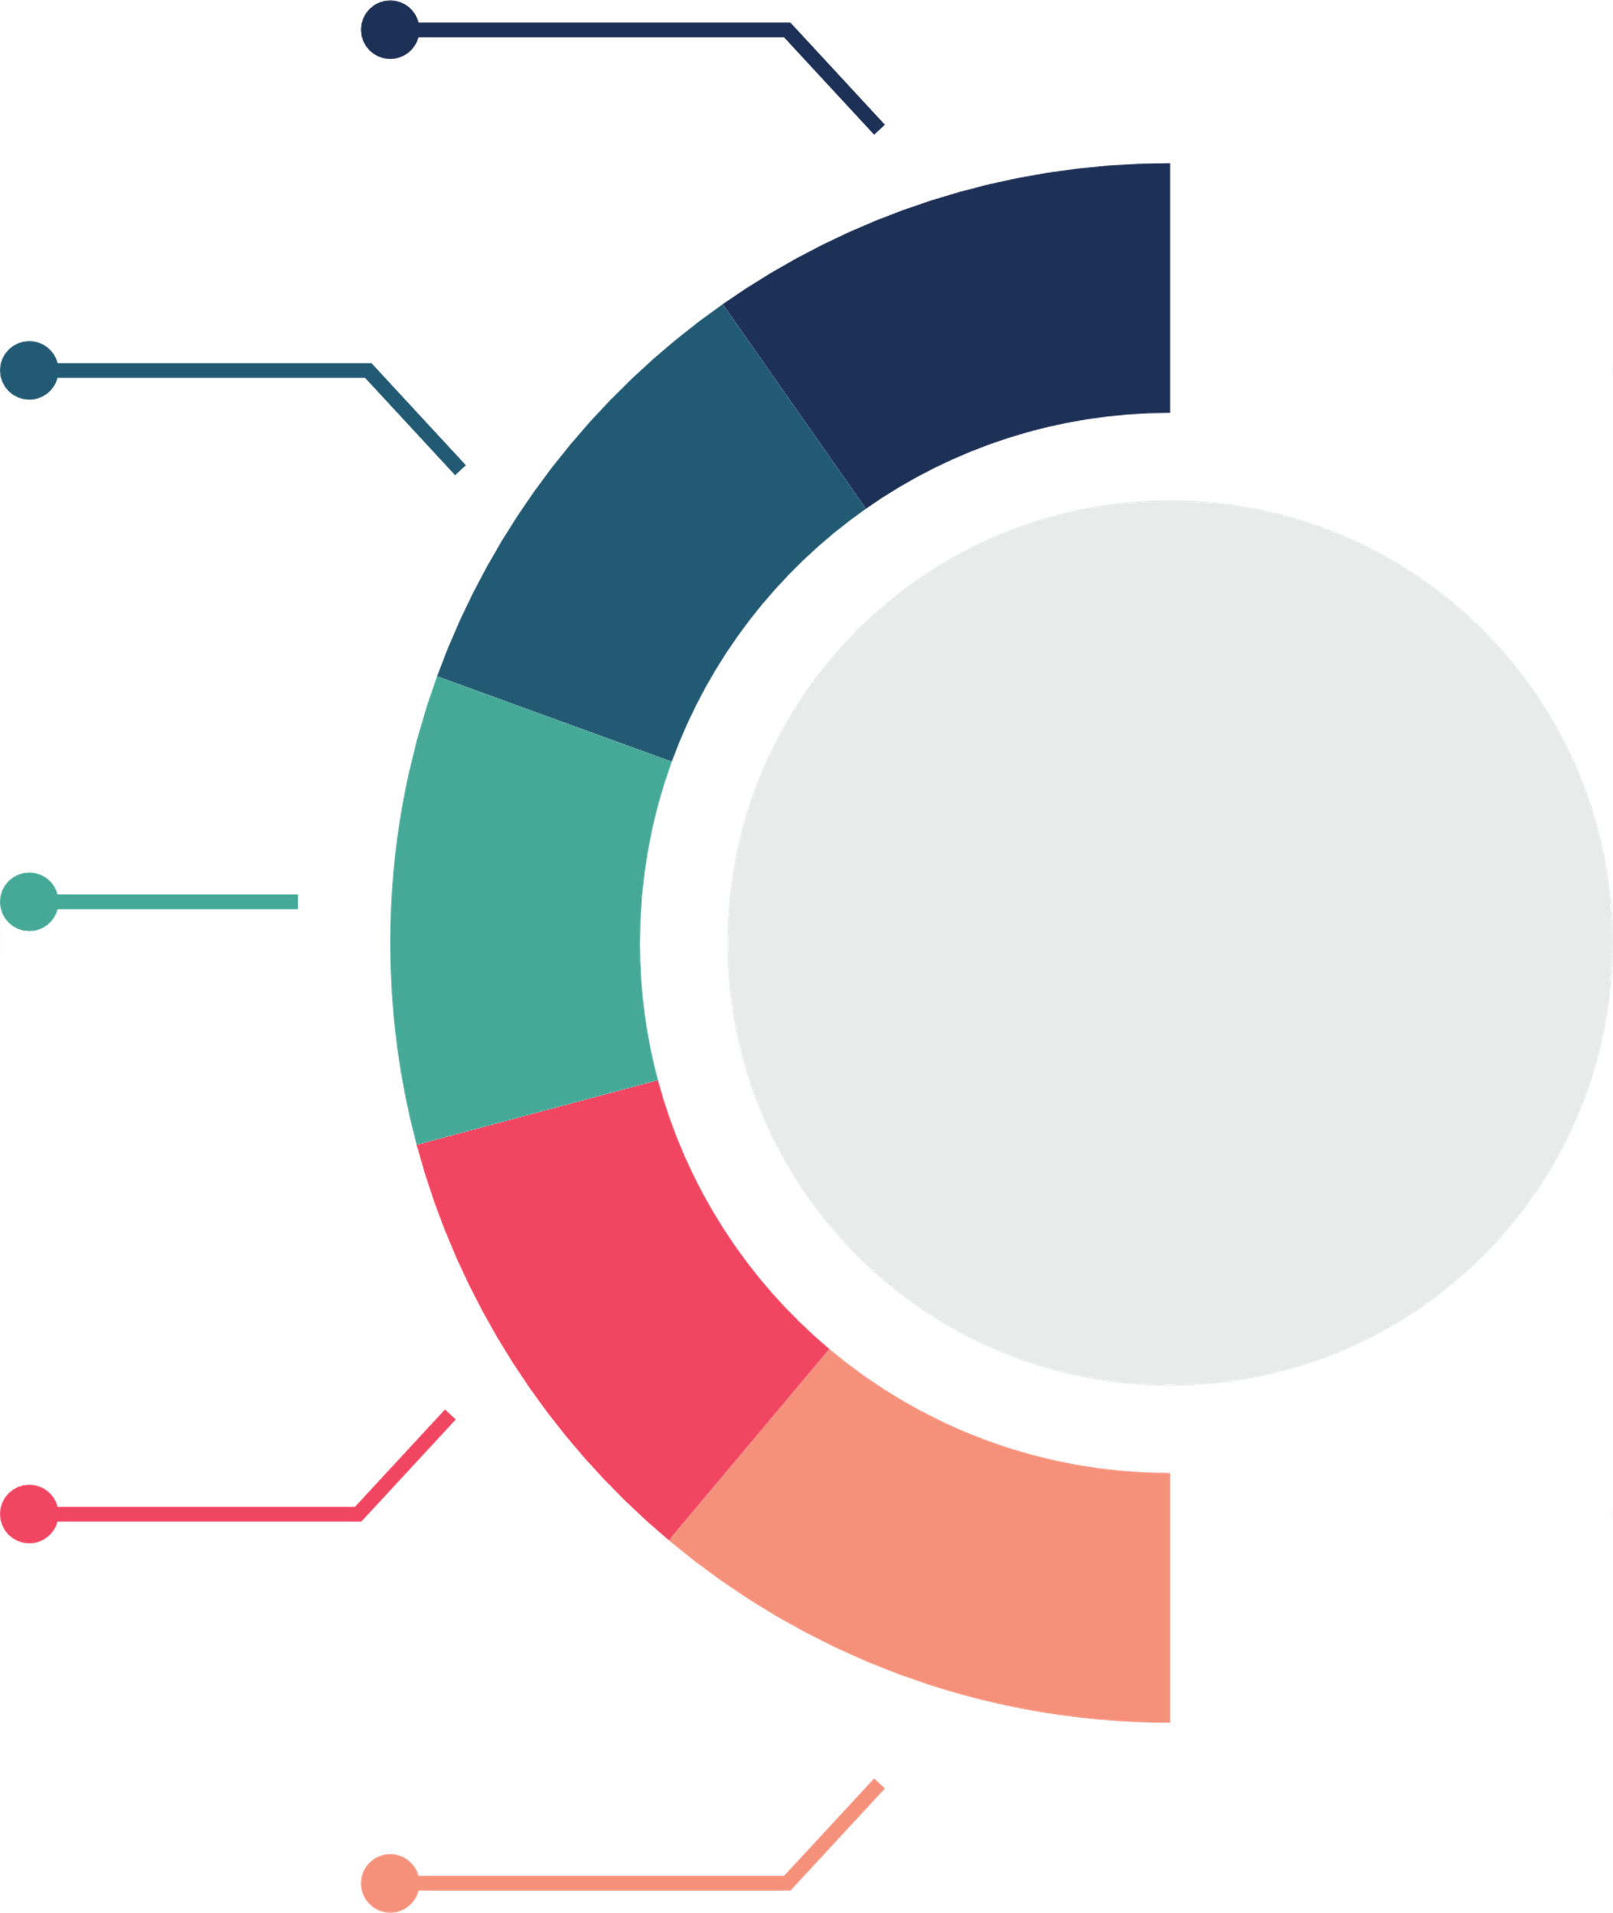
1. What is the overall distribution of stock levels and the risk of stockouts for items with a Popularity Index 100?
2. What are the Top 3 suppliers that supply the top 3 profitable products?
3. What are each City's Trends By Category?
3-Product
4.Which products perform best overall in sales and popularity?
5. Which categories have the highest return rate?
6. What is the Top product in each category?

Slide 7

How do discount, and tax rates affect overall revenue and profit margins?
1-
4-Sales and Revenue
How does the Seasonality impact the sales of specific products?
2-
1. Which customer groups (age, gender) contribute the most to revenue?
3-

